Slide 1
Angel Visits: Region 4 EMC-S Chapters
A Chapter Coordinator &
PACE Experiment

Slide 2
Background
Interest in moving PACE to our Chapters,
Santa Clara Valley: 1st Test.
Southeastern Michigan: 2nd Test.
Extended to Region 4 EMC Chapters
Reached 5 of the 7 Region 4 Chapters.
West Michigan Delayed (‘in house’ Construction)
Milwaukee refused offer.

Slide 3
Topics
Time & Life Management (PACE Topic)
Statistical Process Control in an E³ Laboratory

Slide 4
Santa Clara

Slide 5
Southeastern Michigan

Slide 6
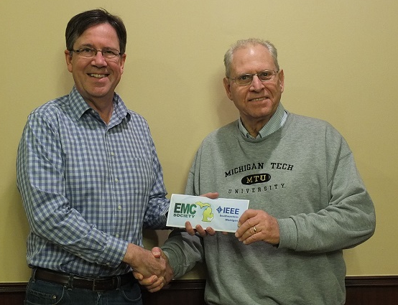
Southeastern Michigan
Note: This Chapter donates $100 to the IEEE EMC-S President’s Memorial Scholarship Fund in the name of each Month’s speaker.

Slide 7
Twin Cities

Slide 8
Rock River Valley

Slide 9
Cedar Rapids
Opps!
I forgot to take a photo…..

Slide 10
Chicago

Slide 11
Chicago

Slide 12
Results & Comments
All considered the PACE element of the evening to be valuable.
Suggested we concentrate ‘Soft Skills’ topics for our younger members.
Consider ‘on-line’ Voice over Power Point presentations for member download.

Slide 13
Moving Forward
TC1 & Education Committees will be encouraged to participate in the development of more PACE topics for member & Chapter use.
Encourage more consistent TC1 sponsorship of ‘Soft Skills’ workshops at all Symposia.

Slide 14
Questions / Comments?

